Slide 1


Python Fundamentals
Innovation Masters
Day 5

Slide 2
If/else – Conditional Statements
if condition:
code
code
elif condition:
code
code
else:
code
code

Slide 3
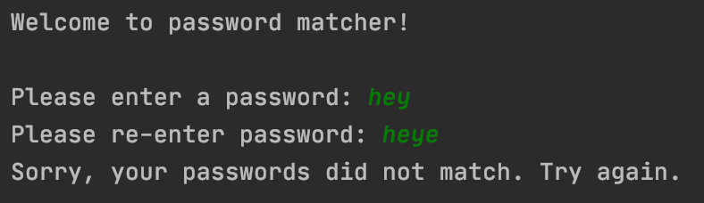
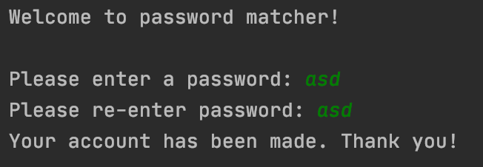
Password matcher
Take two inputs from user and match if they are the same. Respond accordingly.

Slide 4
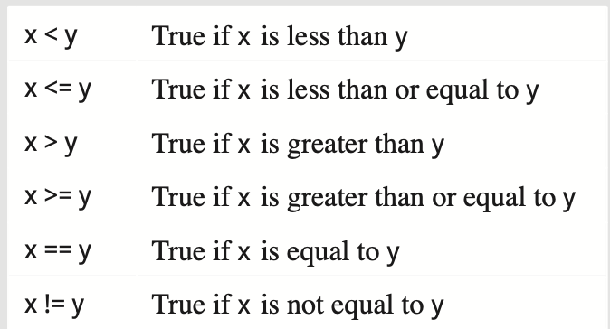
Boolean operators

Slide 5
Homework- Profile Maker
Take in some information from the user and construct a profile for him
Input:
First name
Last Name
Birth year
Hourly wage
Output:
Last, First
Age
Age title
Weekly salary

Slide 6
More details
Age
You need to figure out age from birth year, Hint: 2020 - birthyear = age
Age title
Age titles: 0<= kid <=12; 13<= teen <=19; 20<= adult <=60; 60< old
Salary
Find weekly salary from hourly wage (assume 40 working hours in a week)
Name
LastName, FirstName
Hint: Salary = hourly wage*40

Slide 7
Solution

Slide 8
Commenting
Very useful for you and for the other people who are reading your code.
Short description of your variables, program, and your process so that you don’t forget.
Also good when you want to revisit code or reuse it again.
Syntax: just put a hashtag (#)

Slide 9

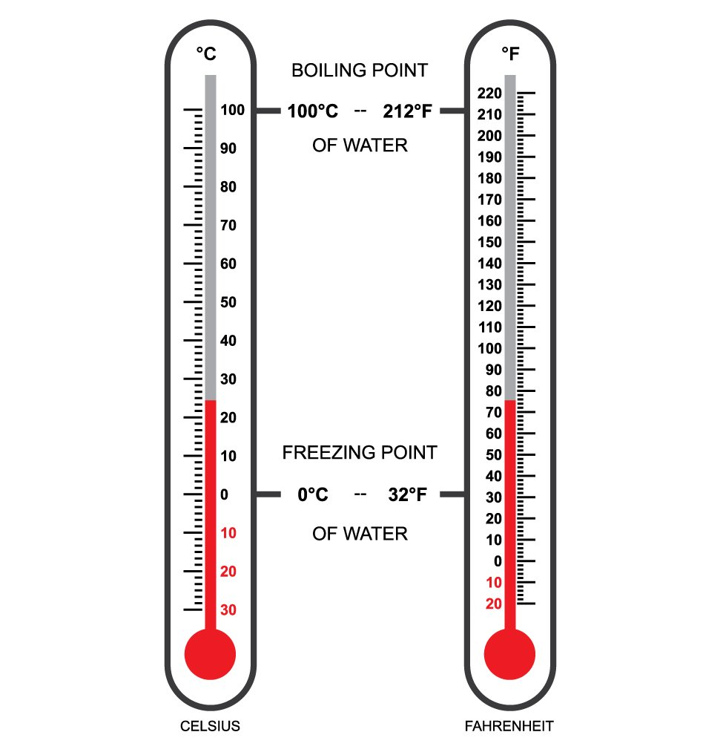
Temperature Converter
In the US we use two units of temperature: Celsius and Fahrenheit (usual)
Imagine your uncle just came from Asia and only knows Celcius
We need to make a converter for him so that he can understand how hot is it outside.
32 F = 0 C (freezing temperature of water)
98.6 F = 37 C (normal body temperature)
Celsius = (Fahrenheit-32) * 5 / 9

Slide 10
Celsius to Fahrenheit
Now imagine you go to Europe and they have their temperature in Celsius, but you are used to Fahrenheit
Let’s make a converter for yourself so that you can convert from Celsius to Fahrenheit.
Fahrenheit = (Celsius * 9 / 5) +32
Do it by yourself

Slide 11
Solution
#Converting from Fahrenheit to Celsius print("Welcome to temperature converter!") far = int(input("Enter Fahrenheit: ")) cel = (far - 32) * 5 / 9 print(cel)
#Converting from Celsius to Fahrenheit print("Welcome to temperature converter!") cel = int(input("Enter celsius: ")) far = (cel * 9 / 5) +32 print(far)

Slide 12
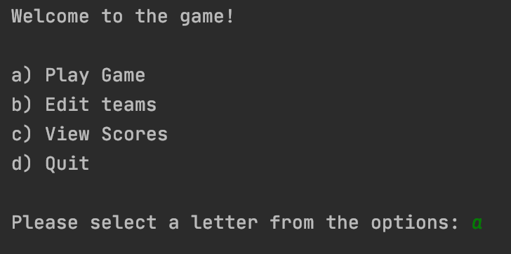
Now we will make a nice menu
In your applications or games, you have menu screens from where you choose what to do
For ex: play game, rules, view high score, make new document, edit, print

Slide 13
Using menus
Let’s make a menu and run commands accordingly
a) Fahrenheit to Celsius
b) Celsius to Fahrenheit
c) Age category
d) Calculate salary

Slide 14
Homework
Going through all the slides so far (Day 1-5)
Review and understand everything
Practice every example problem so far and code it without looking at solution
If you have any questions email me

Slide 15
Tech Talk
Who has something to share?
https://www.youtube.com/watch?v=oJN-LKLNBXA

